Slide 1
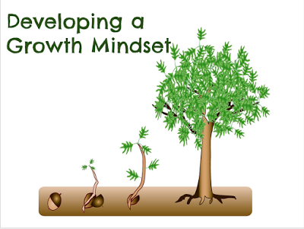

Mindset for success and Student persistence
October 20, 2018

Slide 2
Presented by
Martha E. Casazza
Sharon L. Silverman
Columbus state university

Slide 3

Today’s objectives
Understand mindset theory and the distinction between growth and fixed mindsets.
Examine the research related to mindset theory and its application to the success of college students.
Integrate theory and research to develop principles and strategies for practice.
Apply the principles and strategies to your practice through role plays.

Slide 4
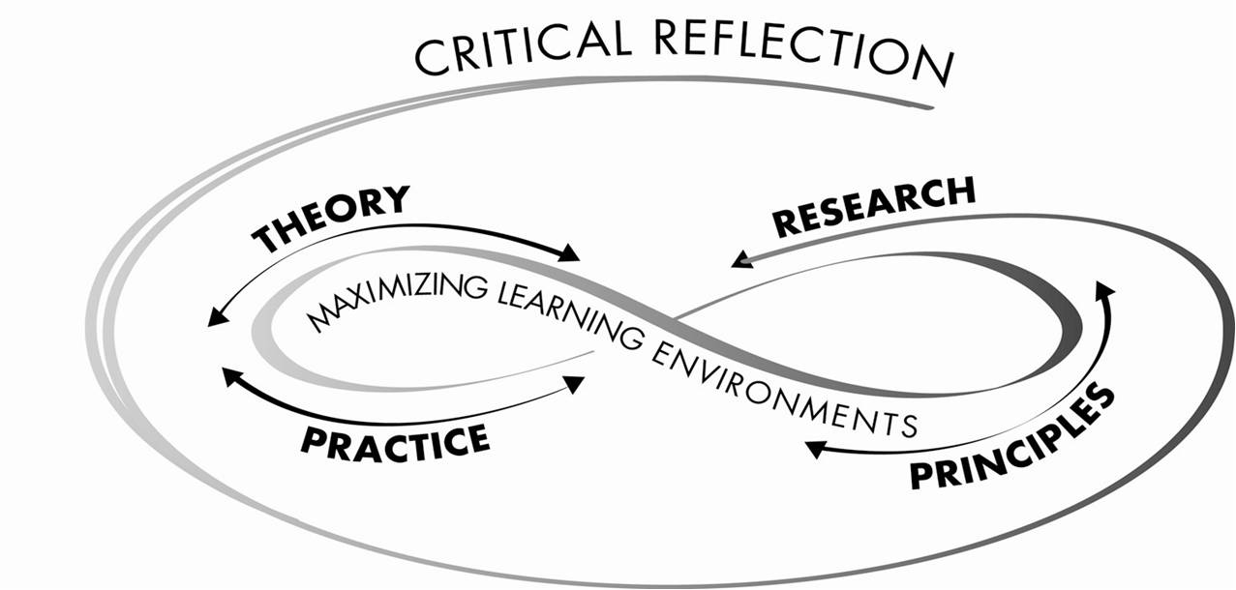
TRPP framework

Slide 5


Self-reflection
I didn’t get that promotion, but it wasn’t my fault. | They told me I wasn’t a “math” person and wouldn’t succeed, so I worked really hard. | If I don’t succeed this time, I‘ll figure it out and try again.
I was on a team, and my partner didn’t really “get it.” We didn’t do very well on the project. | I would have felt awkward asking for help. | I can’t really play cards, so I’ll just watch.
I didn’t apply for that position because the other candidates were way more qualified than me. | I worked really hard on this. I hope it is what you wanted, and I’d love your feedback. | I applied for that position even though I wasn’t sure I was qualified.

Slide 6
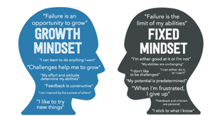
Growth or fixed?
Are we a mixture?
How do we move from fixed to growth?
What are our fixed-mindset triggers?

Slide 7

Student story: charles
His story…
High school star athlete and student
First generation college student
Two scholarships to college
College grades poor: “I was too ashamed to go get the proper help that I needed. I wanted to sort it out on my own.”
Flunked out of college twice
Community support to return
Outcome: High School math teacher

Slide 8

Mindset: what is the theory?
A BELIEF ABOUT YOURSELF
A BELIEF THAT AFFECTS AN OUTCOME
A BELIEF THAT CAN CHANGE
ALL EXCEPT # 3
ALL OF THE ABOVE

Slide 9
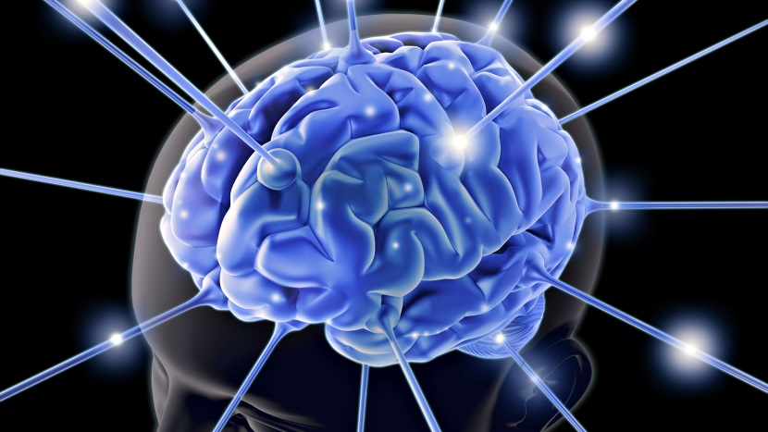
Mindset concept
FIXED
GROWTH

Slide 10
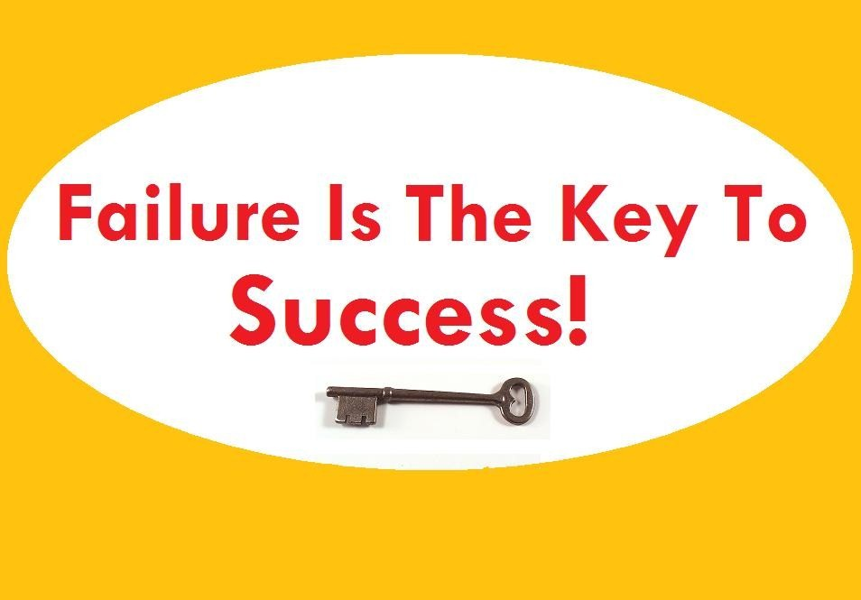
Growth or fixed?
“I’ve missed more than 9000 shots in my career.
I’ve lost almost 300 games.
Twenty six times I’ve been trusted to take the game-winning shot…and missed.
I’ve failed over and over and over again in my life.
And that is why I succeed.”
Michael Jordan

Slide 11

FUNDAMENTAL ASSUMPTIONS ABOUT SELF
Lay theories of personal attributes:
Static traits (fixed entities)
Dynamic traits (cultivated and incremental due to effort)
Different theories in different domains
Molden & Dweck (2006)

Slide 12

Reflections on the concept
Cognitive tests measure developed ability.
Associate “enlightened” with growth mindset: False growth mindset.
Don’t praise only effort: Include the learning!
Need to value persistence over pace.
Consider the brain malleable.

Slide 13
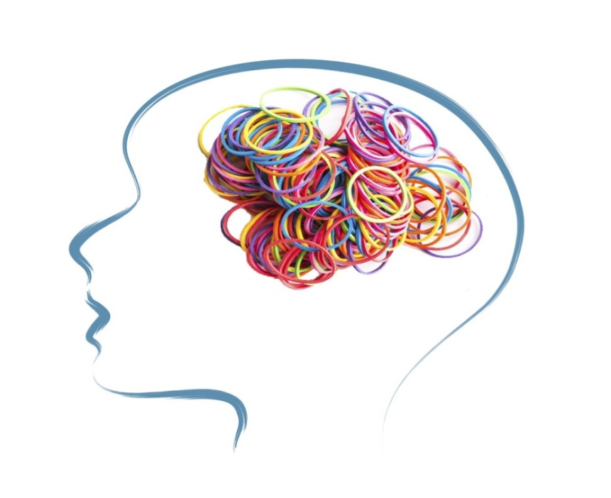
neuroplasticity
CAN WE REMODEL OUR BRAINS?
Create new synapses.
Destroy old synapses.
Create new neurons.

Slide 14
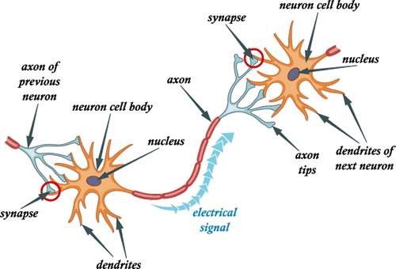
CORE PRINCIPLES
To develop new neural connections and strengthen existing ones:
Be engaged.
Focus intensely.
Strengthen through practice and making associations.
Change becomes permanent depending on outcome.
Skill mastery weakens disruptive brain activity.
Adapted from Merzenich

Slide 15
Fixed vs Growth (from Developing a Growth Mindset
© 2011, Coert Visser http://solutionfocusedchange.blogspot.com)
Belief | Capabilities are primarily seen as inborn talents which are hardly changeable. | Capabilities are seen as mutable by effort and effective learning strategies.
Tendency | To try to appear as capable as much as possible. | To try to learn and improve as much as possible.
Challenges | Are avoided because, in case of failure, they can give an impression of lack of talent. | Are embraced because you can learn from them and they can lead to growth.

Slide 16
Fixed vs growth
View on Effort | Is seen as an indication of a lack of talent. | Is seen as normal and a necessary step to growth.
Response to Adversity/Failure | Is seen as an indication of a lack of talent, often leads to giving up early. | Is seen as an indication that more effort and/or better strategies are needed.
Response to Criticism | Self-defeating defensiveness; own mistakes are not recognized or admitted. | Inquisitive and interested, eager to learn and open to feedback and suggestions.

Slide 17
Fixed vs growth
View on Success of Others | Is seen as a threat because these other people might be viewed as more talented. | Is seen as inspirational because lessons can be drawn from it for further learning.
Impact on Own Development | Potential is under-utilized which is seen as a confirmation of one’s own fixed mindset. | Potential is developed which is confirmation of one’s own growth mindset.
Effect on Other People | Can impede cooperation, feedback, and growth. | Can invite cooperation, feedback and tips and stimulate growth.

Slide 18
Moving toward growth mindset
Instead of:
I’m not good at this.
I give up.
This is too hard.
Plan A didn’t work.
My friend can do it.

Slide 19
How about?
What am I missing?
I’ll try something different.
This may take me a while to figure out.
There’s always a Plan B.
I can learn from my friend.

Slide 20

Mindset: EVIDENCE-based ?
What is the research ?
Achievement and Motivation
External Expectations
Feedback
Believe in You Model

Slide 21
achievement and motivation
Significant outperformance after two years for growth mindset cohort
Evidence
Monitored grades over two year period of those with similar mathematics achievement at start
Growth: focused on learning, believed in effort, showed resilience
Fixed: worried about mistakes, looking smart, defensive with setbacks
Blackwell, Trzesniewski & Dweck, 2007

Slide 22
achievement and motivation
Gain in self-confidence due to expectations:
Evidence
Employees in computer training course: ½ put into fixed mindset/ ½ put into growth mindset
Growth mindset: gained confidence despite mistakes
Fixed mindset: lost confidence due to mistakes

Slide 23
external expectations
Effects of teachers’ mindsets at beginning of school year
Evidence
With fixed mindset: low achievers remained low achievers; learning is student’s responsibility
With growth mindset: low achievers became moderate to high achievers; learning is collaborative
Rheinberg (as cited in Dweck, 2006)

Slide 24
Impact of feedback
Effect of Instructor Feedback
Evidence
“I have high standards but I believe you have the potential to meet them, so I am providing this critical feedback to help you meet those standards.”
    80% revised essays based on his feedback
    39% revised essay when only criticism provided
Yeager et al (2013)

Slide 25
feedback
Neural mechanisms during error feedback
Evidence
Electrical brain signals studied following college students taking general knowledge test
Growth mindset students: more attention to corrective information and more likely correct mistakes on retest
Mangels et al (2006)

Slide 26
feedback
Effect of parental feedback on adolescents
Evidence
More trait messages received (about their intelligence) = fixed theory of intelligence:, ability over effort attributions for failure, negative effort beliefs, showed lower grades
More process messages received (about study strategies or learning), = growth theory of intelligence
Dweck and Lennon (2001)

Slide 27
believe in you model

Slide 28
Believe in you model
Interviewed college students with significant barriers who achieved success
Evidence
100% held growth mindset belief
Correlated with persistence, self-efficacy and emotional awareness
100% reached academic goals
Casazza & Silverman (in publication)

Slide 29
Statements about mindset
Your ability is something very basic about you that you can’t change very much.
You can learn new things, but you can’t really change how intelligent you are.
No matter how much intelligence you have, you can always change it quite a bit.
You can always substantially change how intelligent you are.
Dweck (2006, p. 12)

Slide 30
From kaitlyn
“When you’re green, you’re growing. When you’re ripe, you rot.”

Slide 31
From Charles
“Intelligence to me is your ability to focus on learning the task at hand. Many people have that ability, but some people choose not to use it…you have some students that are not doing well in class, but they know the name of every song out there. They’re intelligent in that realm…so I disagree that intelligence is fixed.”

Slide 32
Thinking about charles
What mindset did Charles have in high school?
How did it change in college?
What behaviors made a difference?
How do you think he interacts with his own students now?

Slide 33

PRINCIPLES FOR PRACTICE
AFFIRM EFFORT AND PROGRESS.
ENCOURAGE RISK AND ASSIGN VALUE TO IT.
CREATE NONJUDGMENTAL CLIMATE.

Slide 34

General framework
Inspire Belief.
Recall other challenges.
Explain neuroplasticity.
Facilitate gradual, persistent growth.
McGuire (2015)

Slide 35

Practical strategies
Structured feedback
Space to make mistakes
Strategies for learning

Slide 36

Reflective activity
How does your interaction with students facilitate a growth mindset?
How does your interaction with
students facilitate a fixed mindset?

Slide 37

Self-reflection
Have I changed my thinking about mindset?
How will my ideas help me understand my students?
How will these ideas impact my teaching?
What is my own mindset?

Slide 38
recommended references
Aronson, J,. Fried, C,. & Good, C. (2002). Reducing the effects of stereotype threat on African American students by shaping theories of intelligence. Journal of Experimental Psychology ,38, 113-125.
Blackwell, L., Trzesniewski, K., & Dweck, C.S. (2007). Implicit Theories of Intelligence Predict Achievement Across an Adolescent Transition: A Longitudinal Study and an Intervention. Child Development, 78, 246-263.
Dweck, C. S. (2006). Mindset: The new psychology of success. New York:, NY: Random House.
Dweck, C.S., & Lennon, C. (2001, April). Person vs. process-focused parenting styles. Paper presented at the meeting of the Society for Research in Child Development. Minneapolis, MN.

Slide 39
Dweck, C.S., & London, B.E. (2004). The role of mental representation in social development. Merrill-Palmer Quarterly (50th Anniversary Issue), 50, 428-444.
Mangels, J. A., Butterfield, B., Lamb, J., Good, C.D., & Dweck, C.S. (2006). Why do beliefs about intelligence influence learning success? A social-cognitive-neuroscience model. Social, Cognitive, and Affective Neuroscience, 1, 75-86.
McGuire, Saundra Yancy. (2015). Teach Students How to Learn. Stylus: Sterling, VA.
Merzenich, Michael. ( 2013 ). Soft-Wired: How the new science of brain plasticity can change your life. Parnassus Publishing, LLC.: San Francisco.

Slide 40
Molden, D.C., & Dweck, C.S. (2006). Finding “meaning” in psychology: A lay theories approach to self-regulation, social perception, and social development. American Psychologist, 61, 192-203.
Plaks, J., Stroessner, S., Dweck, C.S., & Sherman, J. (2001). Person theories and attention allocation: Preference for stereotypic vs. counterstereotypic information. Journal of Personality and Social Psychology, 80, 876-893.
Uttal, D.H. (1997). Beliefs about genetic influences on mathematics achievement: A cross-cultural comparison. Genetica, 99, 165-172.
Yeager, D.S., & Walton, G. (2011). Social-psychological interventions in education: They’re not magic. Review of Educational Research, 81, 267-301.

Slide 41
For further information
TRPP Associates
1152 West Farwell
Chicago, Illinois 60626
www.trppassociates.com
Martha E. Casazza, Ed.D.
casazza@trppassociates.com
Sharon L. Silverman, Ed.D.
silverman@trppassociates.com

