Slide 1
NADE conference DENVER, COLORADO
February 27, 2013
Martha E. Casazza, Ed.D.
Sharon L. Silverman, Ed.D.

Slide 2
Thinking and acting disruptively to innovate

Slide 3
expectations for today
Yours
Ours

Slide 4
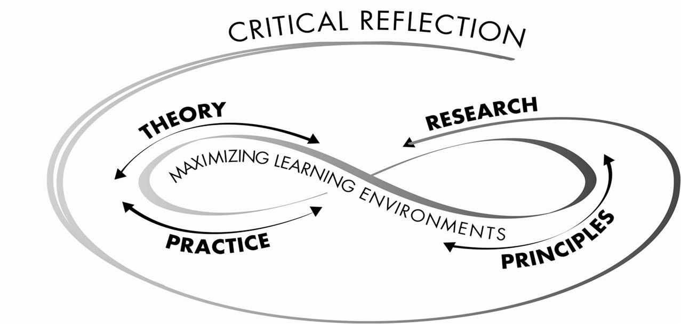
TRPP framework

Slide 5
Looking at trpp
Theory
Research
Principles
Practice
Critical reflection
Maximizing learning environments

Slide 6
Today’s challenge
How do we make our practice more student-centered?
Starting with theory and research…

Slide 7
What is disruptive innovation?

Slide 8
How do you become a disruptive innovator?*
Question
Observe
Network
Experiment

Slide 9
QUESTION…participatory culture lens*
Are there low barriers to creative expression and active participation?
Is there informal mentoring from experienced to novice?
Is there a sense of connection to each other?
Is there a sense of ownership in what is being created?
Is there a strong sense that contributions matter?
* Based on Henry Jenkins (Official blog: October 20, 2006)

Slide 10
OBSERVE…LEARNER-CENTERED LENS*
Is student prior knowledge helping or hindering?
How are students organizing knowledge?
Are students motivated to determine, direct and sustain their learning?
Are students acquiring skills, practicing integration and applying to develop mastery?
Is there enough goal-directed practice and targeted feedback?
How are current levels of development affecting social, emotional and intellectual climate?
Are students monitoring and adjusting approaches to learning?
*Theory & Research-Based Principles of Learning from Eberly Center for Teaching Excellence : Carnegie Mellon University

Slide 11
Networking and experimenting
What types of networking work for you?
Please share an example.
How have you “experimented?”
What caused you to experiment?
How did you measure the outcomes?

Slide 12
Associate and apply*
Connect the 4 behaviors.
Find relationships.
Apply to your learning environment.
*From The Innovator’s DNA, Dyer, Gregerson, Christensen, 2011.

Slide 13
Developing principles for practice
Listening to Student Voices….
https://www.dropbox.com/sh/6vz1i987oslege3/_8VA9de9aa

Slide 14
Applying principles to practice
Principle for helping Algernon
______________________________________________________________
THEORY | RESEARCH | PRACTICE

Slide 15
CHALLENGES
What specific challenges are likely to occur while meeting Algernon’s needs?
How might they be overcome?

Slide 16
Develop your own case study
Pair up with someone and share and describe challenges you have faced or are facing with a student or students.
USE DISRUPTIVE INNOVATION to
Identify an approach to meeting the challenge(s) and create a principle to describe it.
Brainstorm practice ides for achieving the principle.
Try to think of a theory or piece of research that supports the principle.

Slide 17
Who are the real disrupters?
The real disrupters are individuals who approach challenges with a clean lens, bringing together diverse experiences, knowledge and opportunities.

Slide 18
For further information
TRPP Associates, LLC
401 N. Michigan Ave. Suite 1200
Chicago, Illinois 60611
312-836-3760
www.trppassociates.com
Martha E. Casazza, Ed.D.
casazza@trppassociates.com
Sharon L. Silverman, Ed.D.
silverman@trppassociates.com

